Slide 1
Racial Equity Data Hub
The need
How data can help
The role of Tableau
What action you can take

Slide 2
The State of Racial Equity
“Our goal with the Racial Equity Data Hub is to help organizations and advocates learn from each other, and see how data is playing a role in equity work across different communities in the U.S.”
Notes:
Racial inequity has reached a breaking point in the U.S. In 2020, COVID-19 exposed longstanding disparities between White people and people of color, who have been sickened disproportionately by the virus and borne the largest share of economic devastation it’s brought. Halfway through the year, the murders of George Floyd, Breonna Taylor, and more Black and brown people by the police brought systemic race-based violence and discrimination to the surface. These events have forced a long-overdue true reckoning with racial injustice in the country.
While individuals, institutions, and companies have learned to say the right things over the years—to pay lip service to the ideas of equity and justice—now is the time to start doing. Every person and organization has a role to play, and this work must start in recognizing ways in which they have previously upheld or failed to address white supremacy and racism against Black people and people of color. Once history and patterns have been confronted, bold, systemic change is required to root out racism in all its forms, and build a truly equitable society.

Slide 3
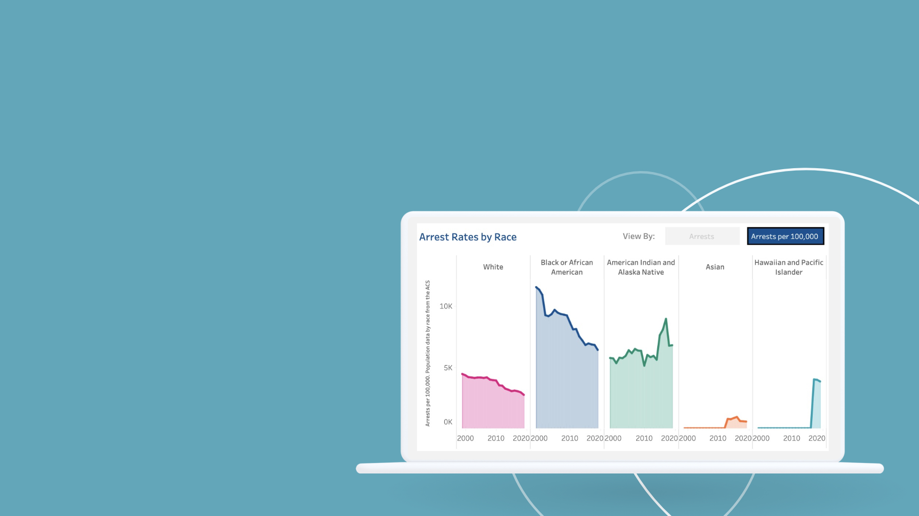
The Promise of Data
Data Democratization
Capacity building at the community level
Areas of focus
Notes:
We believe in order to truly dismantle systemic issues like racism, we need robust data on its reach, its many impacts, and the efficacy of potential solutions. Data is not required to prove that racism exists. On the contrary: Racism is visible and evident in all corners of our culture. But with an issue this widespread, data can be a way in—a means of understanding exactly how racism manifests in every sector and area of society.

Slide 4
Tableau’s Role:
Using data to elevate the voices and work of racial equity experts
Notes:
While we recognize the critical importance of data for racial equity and justice, we are not the experts in this work. As a brand and as the host of the Racial Equity Data Hub, we can be the voice to emphasize the value of data and visualization to inform and empower the work of local influencers pushing for change in their communities. We can underscore that this is a priority for Tableau.
When the content on the Hub delves into specific issues around racial inequities, the impacts of racism, or potential solutions or policy programs, the voices of contributing organizations will take the lead. Leading organizations like PolicyLink, Urban Institute, and Feeding America contribute expertise, unique data, and case studies on the power of data to illuminate disparities and point to solutions.
We will aim to elevate their voices and work. They are the experts in both the impacts of systemic racism and potential solutions. Our voices can come together when data visualization, Tableau, and the Tableau community of data enthusiasts are able to elevate the work of leading experts and bring something new to the table.
While this initiative is resourced in part by Tableau Marketing, it is not a marketing initiative. We are not in this work because it is lead or revenue generating. Instead, we are focused on our belief that data is an essential tool for making progress against racial inequity. As a leader, Tableau has a responsibility to step up and offer our resources where we can.

Slide 5
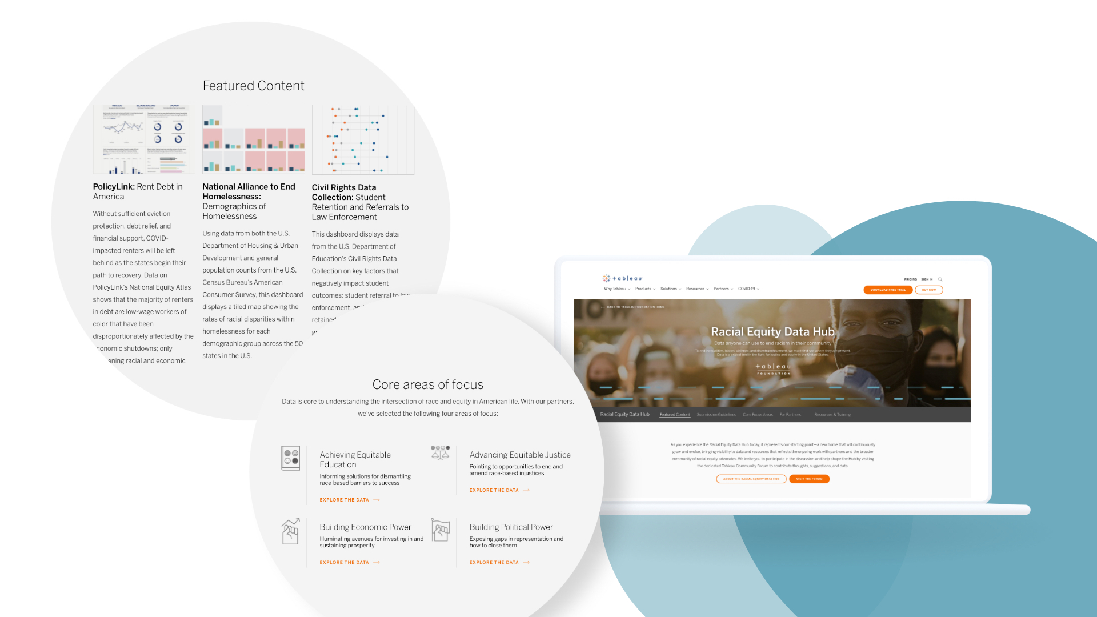
The Racial Equity Data Hub
Notes:
Launched on Feb. 16, 2021, the Racial Equity Data Hub is a platform for organizations and advocates to access relevant data, analyses, and resources to advance data work in the racial equity and justice space.
Our goal is to help organizations and advocates learn from each other, and see how data is playing a role in equity work across different communities in the U.S.
Speifically, we aim to:
Create advocates among local community organizations (NGOs), “equity” influencers and Salesforce/Tableau employees for the Data Equity Hub.
Help people and organizations effectively and ethically use data for achieving equitable education, advancing equitable justice and building economic and political power at the local and national level.
Inspire academics, elected officials and business leaders with the power of data as a catalyst for change and a tool for good in the world.
Showcase impact from the Racial Equity Data Hub and highlight the work from PolicyLink and the Urban Institute, among others.

Slide 6
The Importance of Data Disaggregation & De-weaponization
This effects the disbursement of government funds, services and other resources in various ways. (Census, HUD etc). Disaggregated data may ensure that resources reach everyone who needs them
The process of breaking down data into smaller subpopulations allows for analysts, researchers and advocates to look at specific marginalized groups, genders, regions etc.
Aggregate categories & visualizations can mask significant variation across groups that could help improve service and benefit provision across the country. This leads to the weaponization of data & data visualization tools (subconsciously)
Disaggregated visualizations allow for a more granular understanding of the needs and experiences of different demographic groups, students and communities. There are more data points available for analysis and it is easier to find outliers
Aggregating race/ethnicity data can hide true implications for individuals & communities, masking the true experiences that people endure.

Slide 7
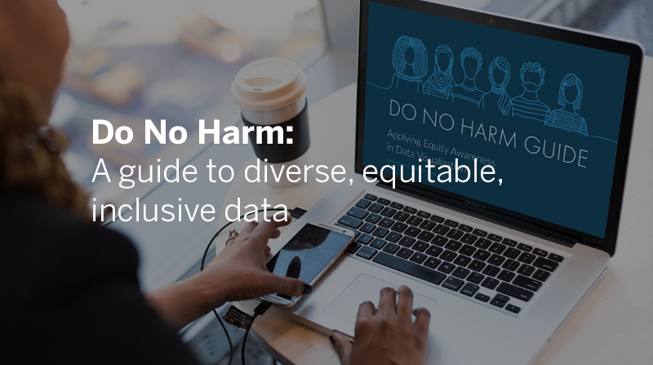
Notes:
Core to our mission with the Racial Equity Data Hub is helping show that how data is portrayed in an incredibly diverse world will impact the meaning of – and actions resulting from –those data.
In June, in partnership with the Urban Institute, we launched the Do No Harm Guide - a how-to guide to ensure anybody working with data does so in a way that presents data through a more diverse, equitable, and inclusive lens. The guide, which can be downloaded or viewed in video form on the Racial Equity Data Hub, addresses the responsibilities we all share in using data with sensitivity and care, in order to further the cause of equity in our society.

Slide 8
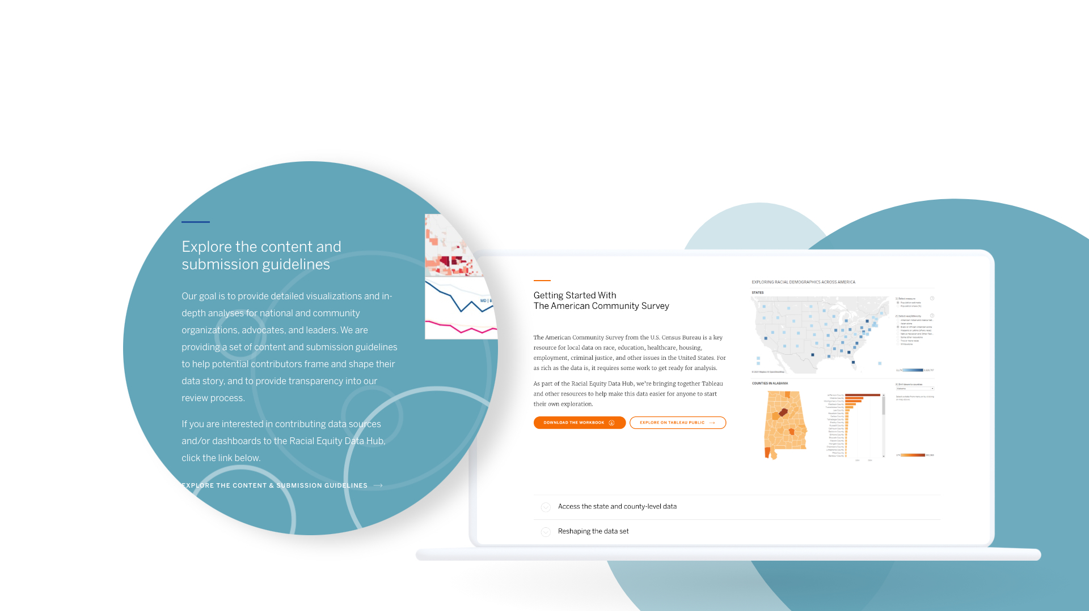
Get involved
Notes:
Work with the data found to the Racial Equity Data Hub to combat racism at the local level.
Submit or encourage others to contribute Tableau visualizations to illustrate racial disparities and opportunities for change across core issue areas:
Equitable Education
Equitable Justice
Economic Power
Political Power
Bookmark the Racial Equity Data Hub so you can follow the content we publish on the Data Hub and share it with your personal networks.
Take advantage of our education and trainign resources on the Hub to elevate your understanding of inclusive analysis.

Slide 9
Our Advisory Board
Shena Ashley Vice President, Nonprofits and Philanthropy, at Urban Institute
Allen Hillery Columbia University adjunct professor and Tableau Social Ambassador
Chantilly Jaggernauth Vice President of Data Visualization and Taining at Lovelytics
Jared Knowles President, Civilytics Consulting
Sarah Treuhaft Vice President of Research at PolicyLink

Slide 10
Racial Equity Data Hub Team | racialequity@tableau.com
Neal Myrick Tableau Foundation Lead
Steve Schwartz Tableau Business Owner
Eillie Anzilotti Content and Marketing Lead
Channing Nesbitt Team Lead
Renee MacLeod Inclusive Marketing Lead
Ali Kramer GTM Lead
Telain Ware Writer
Stephanie Jensen Content Manager
Tim Fry Strategy & Day-to-day Management
Megan O’Connell Creative Management
Sarah Alamshaw PR
Notes:
Channing Nesbitt - Team Lead
Drives long-term strategy for the Hub
Leads Hub partner engagement and dashboard pipeline
Primary spokesperson for the Hub
Tim Fry - Strategy & Day-to-day Management
Long-term strategic planning
Oversees team infrastructure
Manages other Tableau resources (creative, PR, web dev) and consultants
Eillie Anzilotti - Content and Marketing Lead
Leads messaging, content creation
Represents the Hub across Tableau’s marketing org
Stephanie Jensen - Content Manager
Contributes content for the Hub
Manages editorial calendar
Content liaison with other Tableau teams
Neal Myrick - Tableau Foundation Lead
Long-term vision
Tableau Foundation support
Opens doors to strategic partnerships
Steve Schwartz - Tableau Business Owner
Overall Hub business owner
Strategic partner relationships (internal and external)
Communications strategy
Renee MacLeod - Inclusive Marketing Lead
Tableau owner for inclusive marketing
Overall D&I alignment, messaging consistency - internal/external
Sarah Alamshaw - PR
Messaging consulting
Media outreach
Ali Kramer - GTM Lead
Consults on go-to-market best practices
Identifies opps to connect Hub with other Tableau marketing teams/campaigns
Megan O’Connell - Creative Management
Visual design
Manages iterative Hub design changes

