Slide 1
A Lifetime of Support for our Community
July 1, 2020
Eileen Dern, Director Community Services

Slide 2
Community Benefits
MelroseWakefield Healthcare
Community Benefits Mission Statement
“MelroseWakefield Healthcare (MWHC) is committed to building and sustaining a strong, vibrant and healthy community. MWHC dedicates appropriate resources to collaborations with community partners and the utilization of community members’ input toward improving health services. MWHC pledges to act as a resource and to work with the community during emergencies; improve access to care; identify, monitor, and address the unique health care needs within its core communities; and promote healthier lifestyles for residents through health education and prevention activities.”

Slide 3
Overall Health Definitions

Slide 4
Community Benefits MWHC 2019

Slide 5
December 2019 Behavioral Health Listening Sessions
What are the most notable barriers that impact access to behavioral health care in the community?
Lack of available providers
Housing and services for the homeless population.
Lack of communication between agencies and providers.
Stigma and lack of education about available resources
Insurance regulations including “ghost networks”
Confusion about navigating care.
Transportation
Access to services for people with immigration concerns
Lack of trust in medical community
Limited focus on alcohol related problems

Slide 6
December 2019 Behavioral Health Listening Sessions
Which populations are the most vulnerable or at risk?
Homeless
Children
Young adults and children aging out of the education and foster care systems
Seniors.
Community members with suicidality and impacted by suicide
Veterans
Non-English speaking
“Rising risk” populations, e.g. grandparents, caregivers
Trauma survivors, including domestic violence
LBGTQ community
People with food and economic insecurity
People receiving mental health care in primary care

Slide 7
December 2019 Behavioral Health Listening Sessions
3. How can MelroseWakefield Healthcare collaborate with our community partners to improve behavioral health care in the community?
• Spearhead a regional behavioral health coalition
• Participate in workforce development for behavioral health professionals
• Share expertise with the community in a wide range of settings
• Increase availability of services
• Promote interagency communication
• Collaborate on expanded housing/shelter
• Improve transitions of care
• Decrease wait time and levels of services in the ED, e.g. recovery coach
• Enhance access to substance use treatment in primary care
How can MelroseWakefield Healthcare collaborate with our community partners to improve behavioral health care in the community?
Spearhead a regional behavioral health coalition
Participate in workforce development for behavioral health professionals
Share expertise with the community in a wide range of settings
Increase availability of services
Promote interagency communication
Collaborate on expanded housing/shelter
Improve transitions of care
Decrease wait time and levels of services in the ED, e.g. recovery coach
Enhance access to substance use treatment in primary care

Slide 8
Covid 19- Impact on Community Health
Fear and worry about health and the health of loved ones.
Worries about finances/job, or loss of support services.
Changes in sleep or eating patterns.
Difficulty sleeping or concentrating.
Worsening of chronic health problems.
Worsening of mental health conditions.
Increased use of tobacco, and/or alcohol and other substances
Help is available!
Information from the CDC Website

Slide 9
What is MWHC’s Community Response to Covid 19?
Covid 19 testing with referral
Safe inpatient and emergency care
Telehealth and in-person visits
Supporting elders with monthly newsletter, check-ins and programming
Delivery of care kits, food packages, clothing, and diapers
WIC services by phone
Childbirth/Parenting programs through Zoom and resources through Constant Contact and Facebook
Virtual Home Visits and groups for young parents
Supporting community partners
Malden Webinar
Eliot Community Services

Slide 10
Next Steps: We Need You!
Collaborate on a Regional Behavioral Health Coalition with partners from the community
MVPHC
NAMI
Middlesex County DA
Fall Summit Planning
Hybrid Model
Help is needed
DoN Funding to address the following:

Slide 11
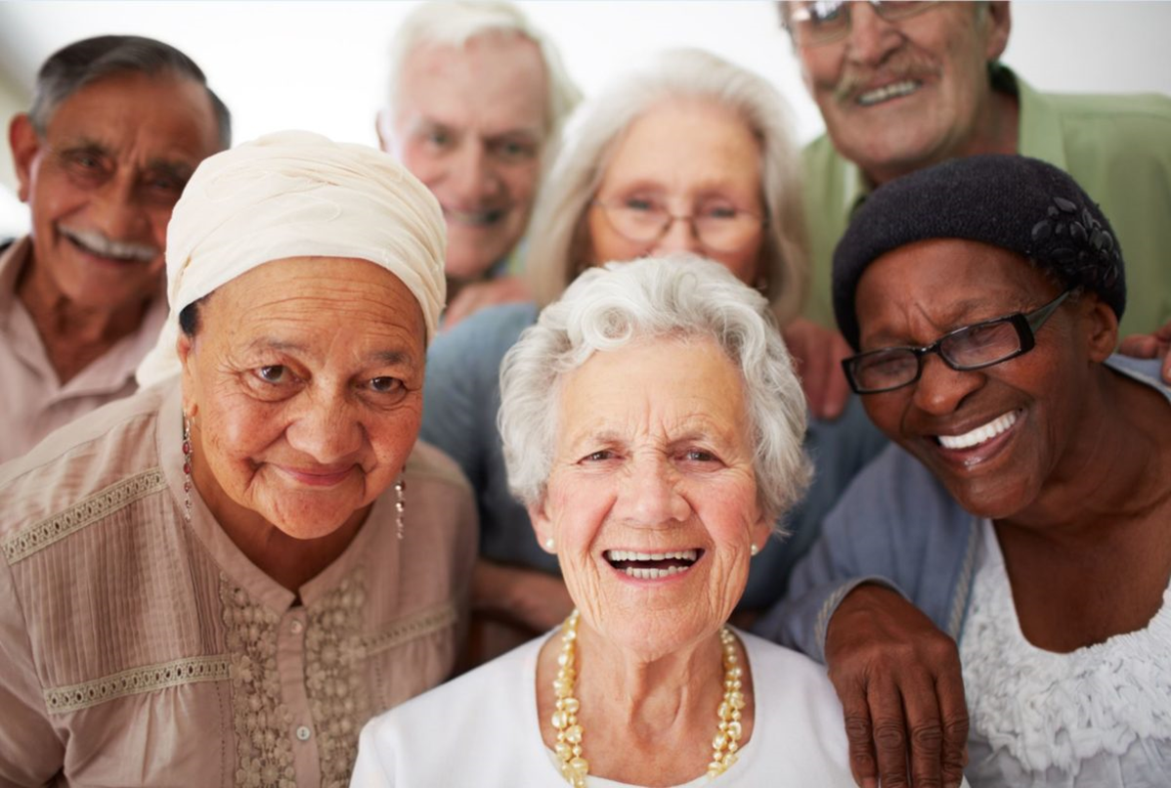
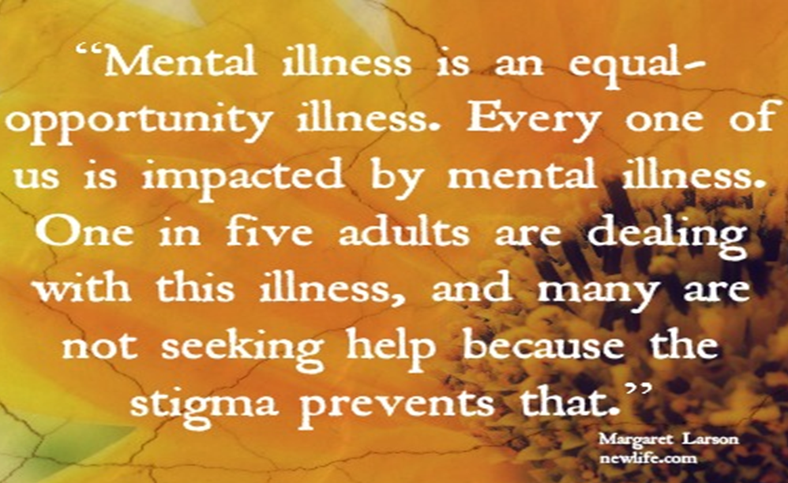
Next Steps: We Need You!
Improve childhood resilience in schools
Reduce elder isolation
Address stigma in the community

Slide 12
Your Questions?

Slide 13
THANK YOU!

