Slide 1
Moving Transparency Forward
Jeff Reisig, Yolo County District Attorney

Slide 2
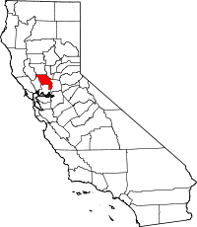
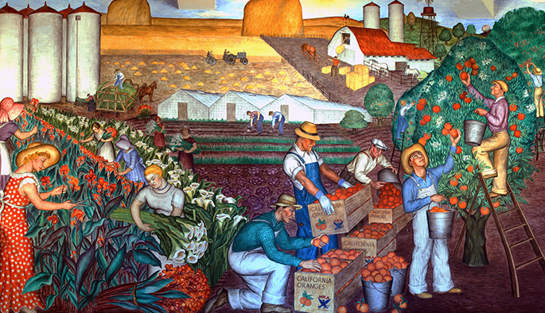
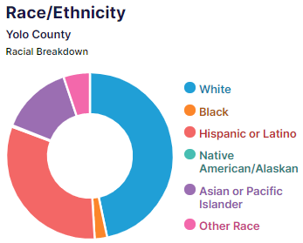
Yolo County

Slide 3
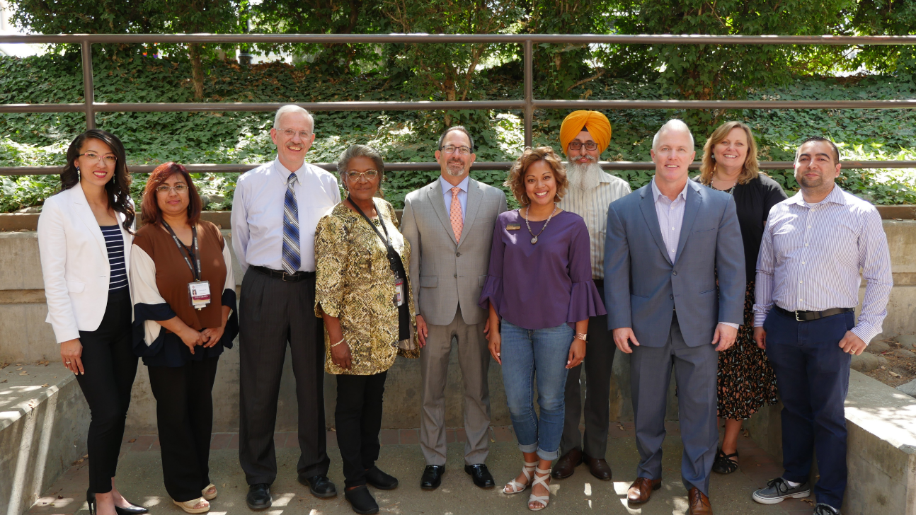
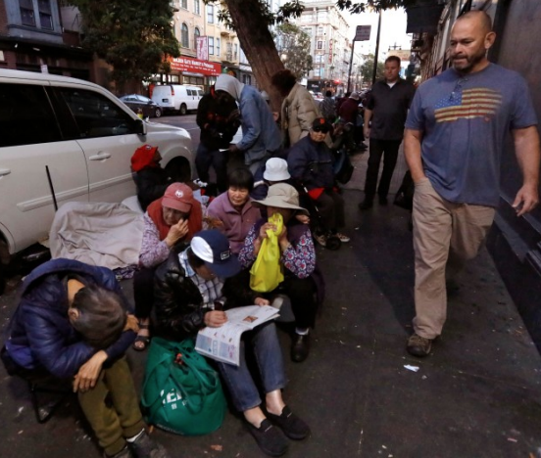
Yolo District Attorney’s Office

Slide 4
The Problem

Slide 5
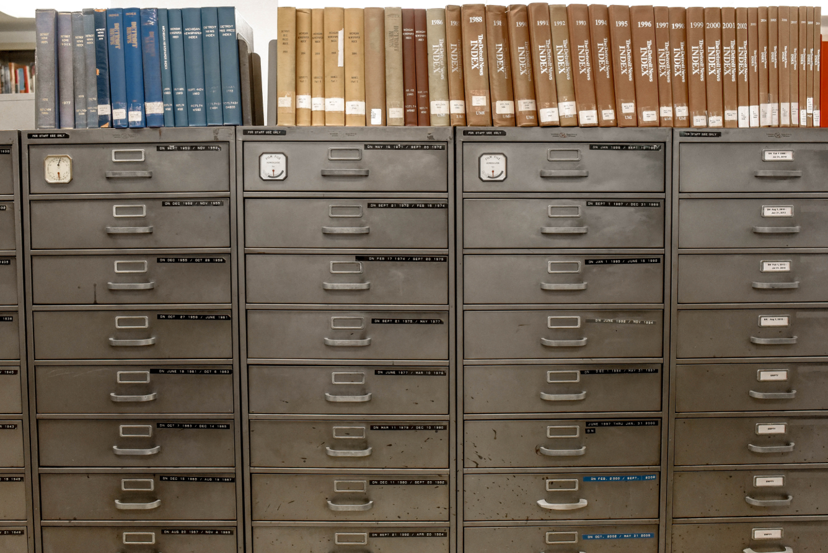
Some Barriers of Transparency

Slide 6
Solutions
Define your moonshot
Create a strategy
Make it a team effort!

Slide 7
Our Team Effort

Slide 8
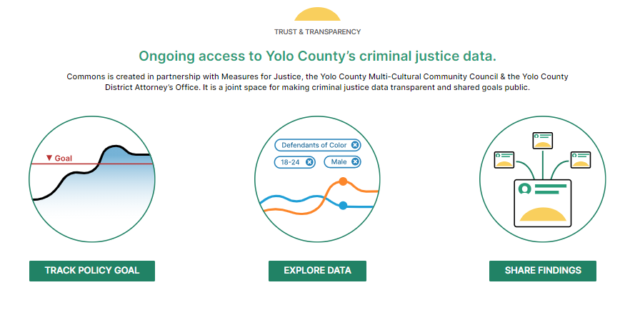
The Result

Slide 9
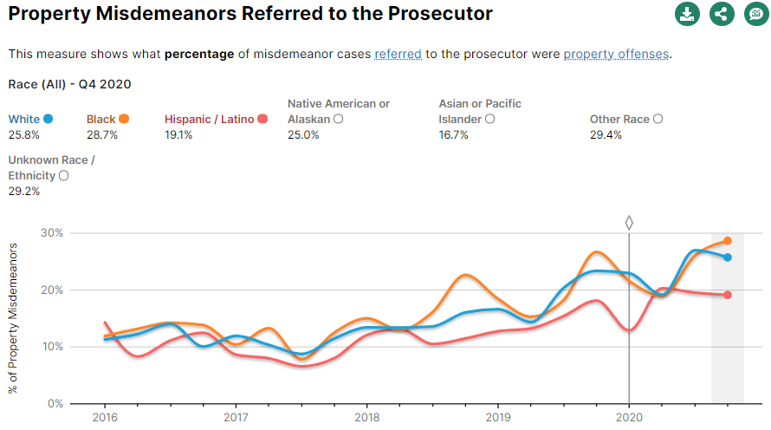
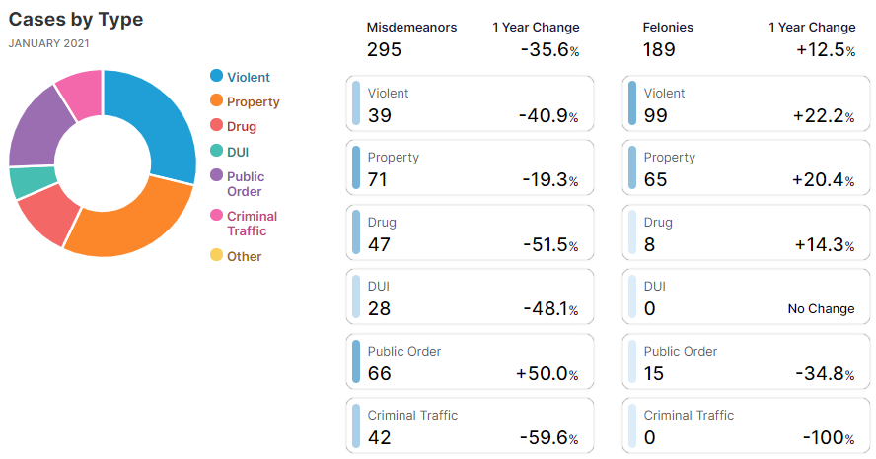
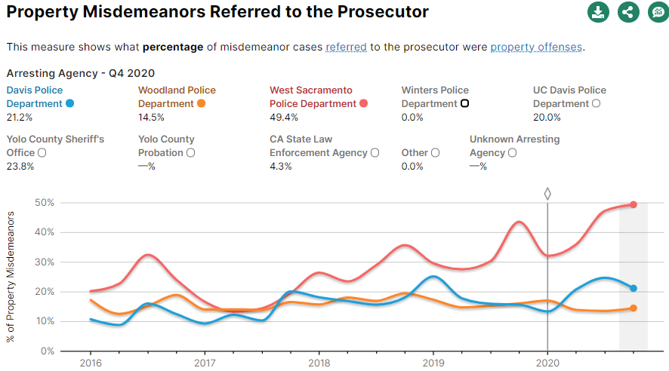
The Result

Slide 10
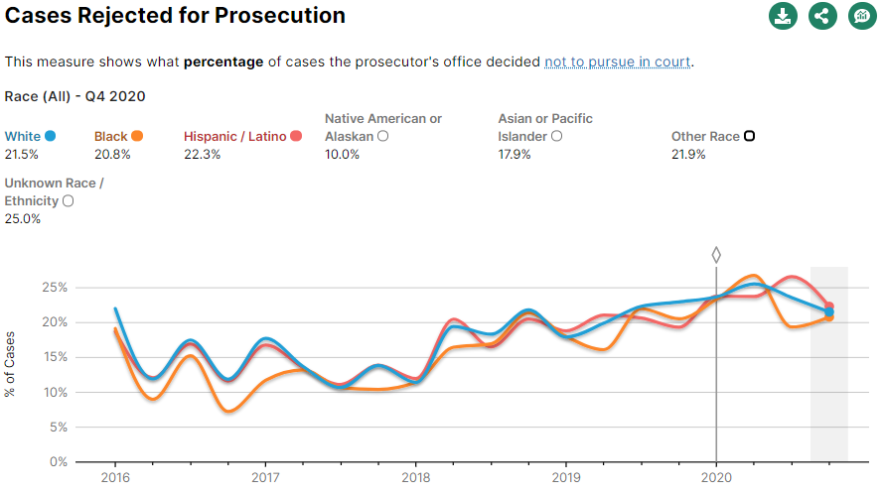
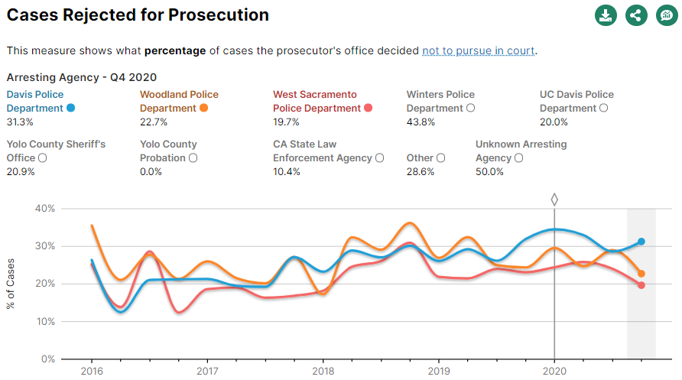
The Result

Slide 11
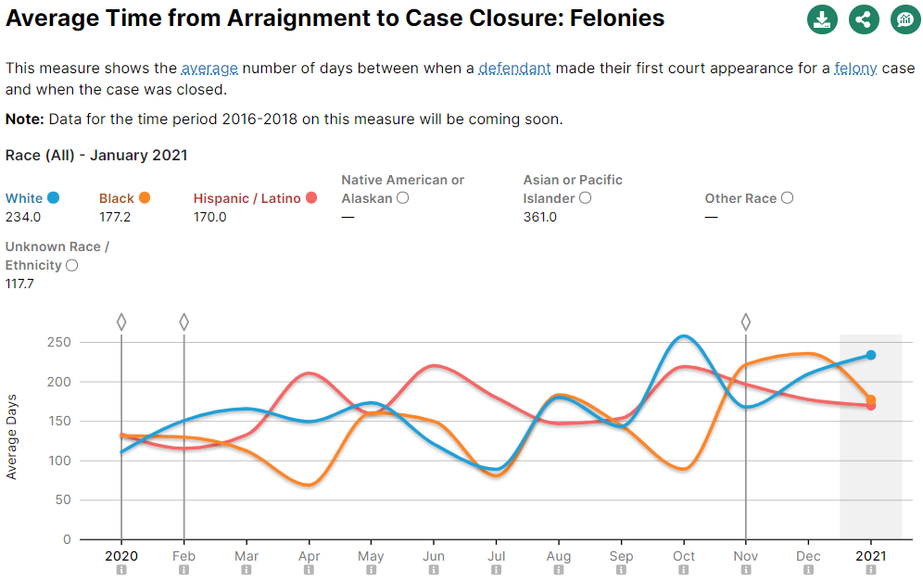
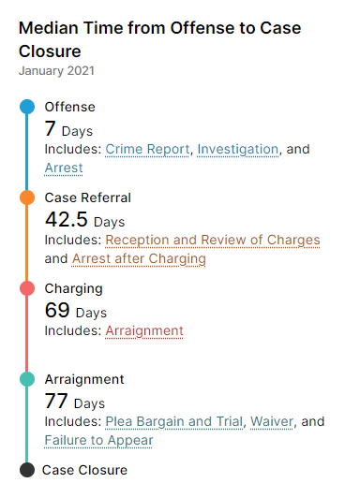
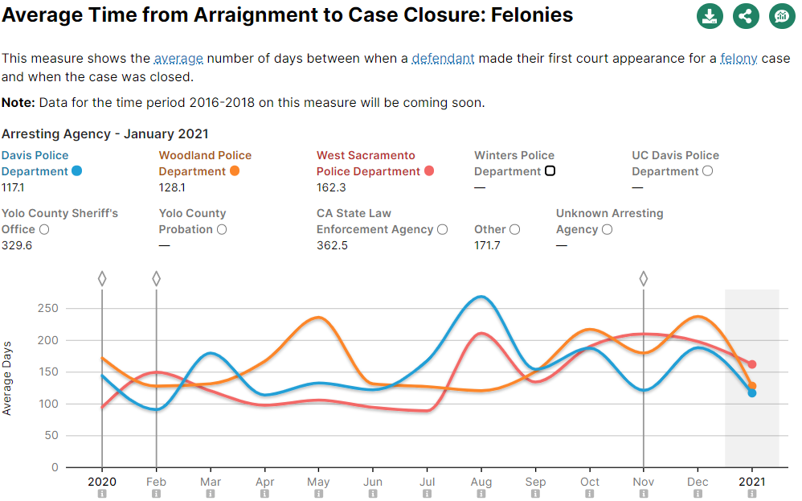
The Result

Slide 12
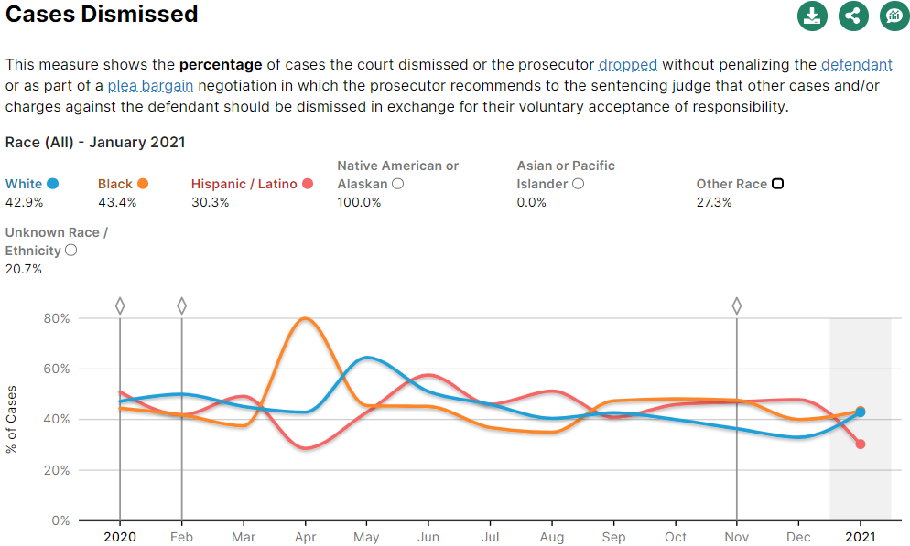
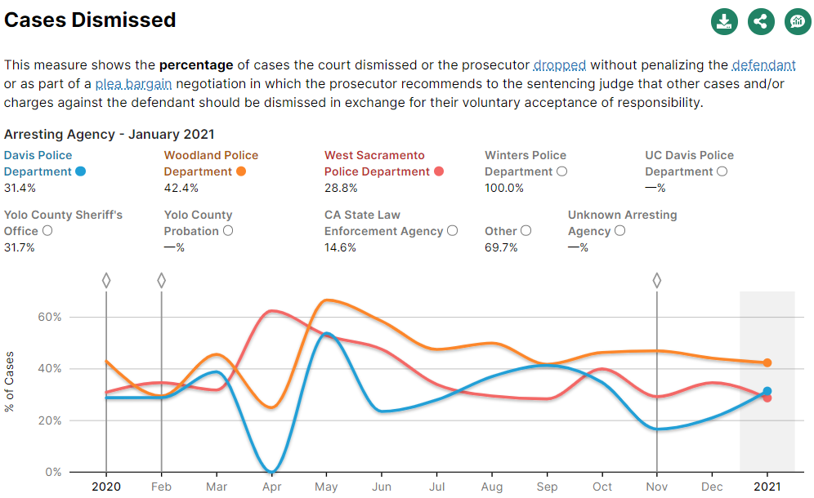
The Result

Slide 13
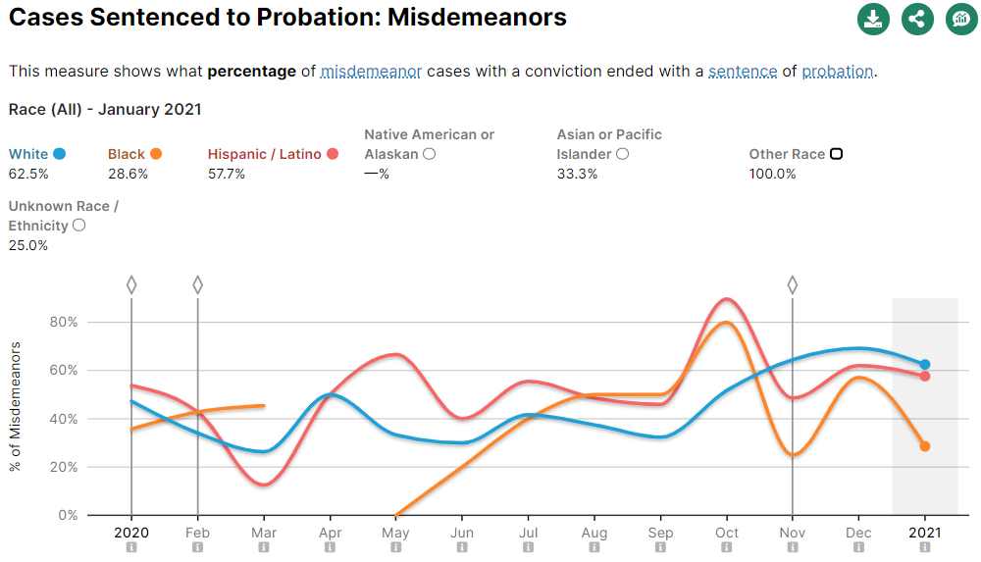
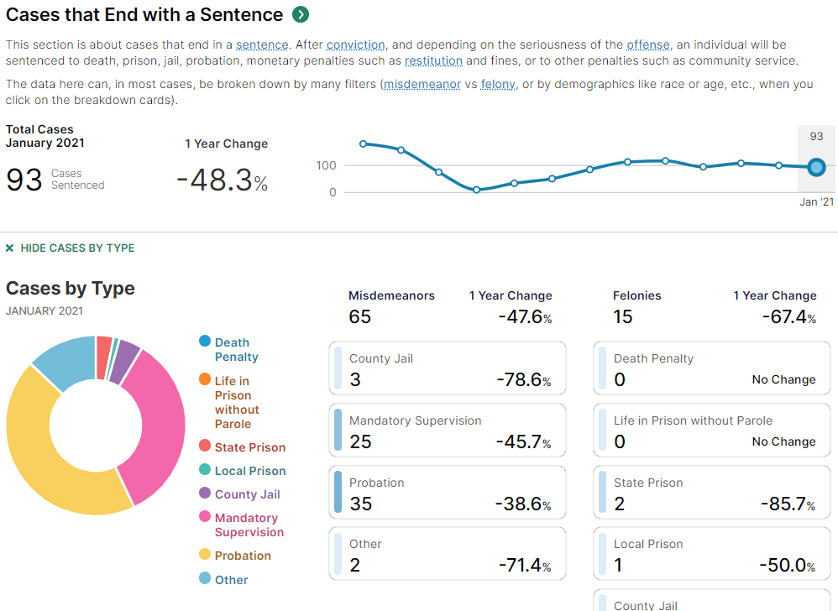
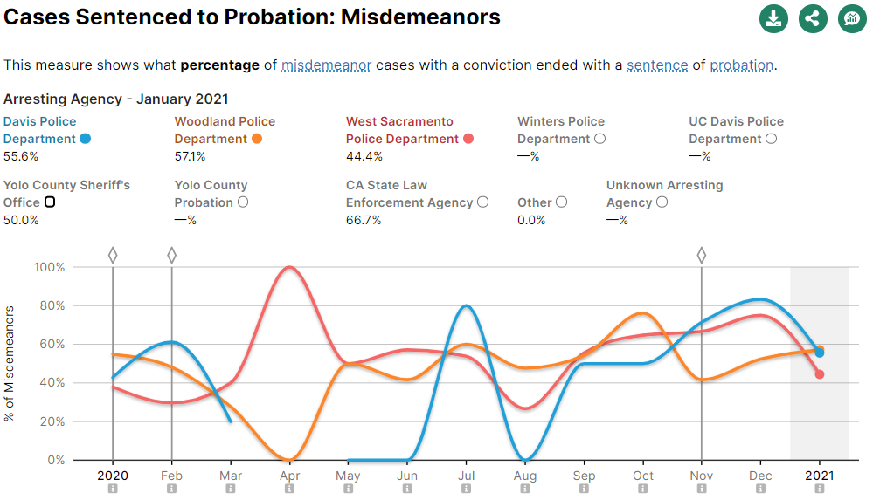
The Result

Slide 14
Lean Into Change

Slide 15
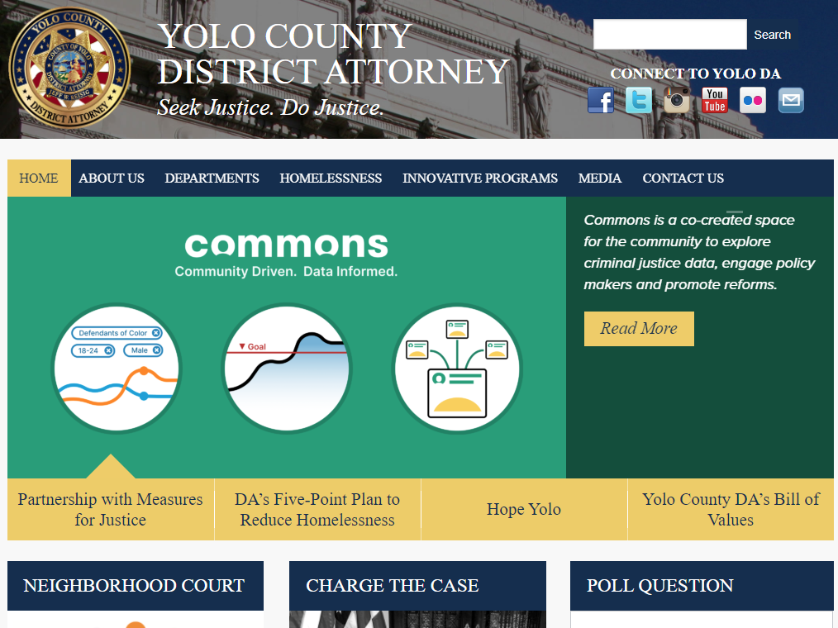
Make It Easily Available

Slide 16
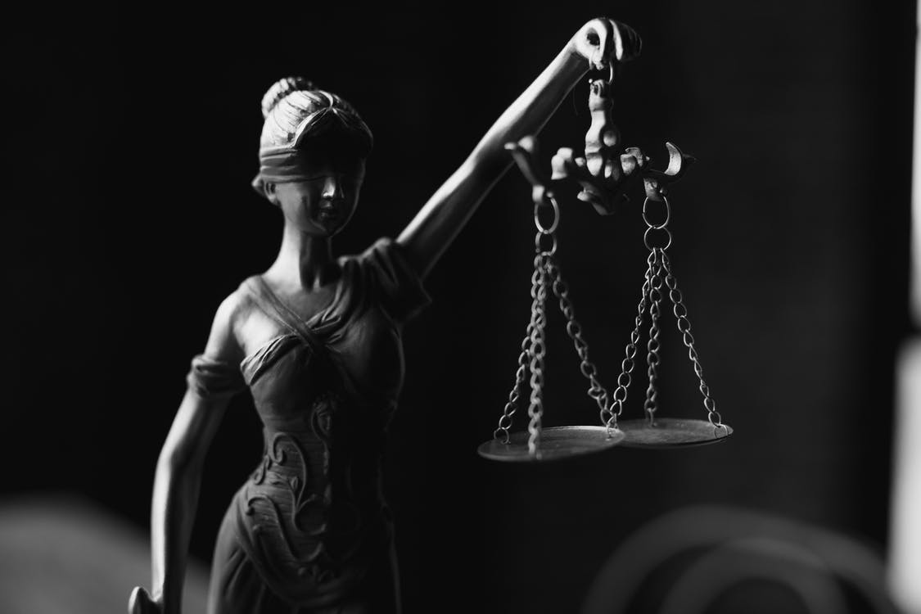
Race-Blind Charging
The DA cannot control what cases are sent for review from the Police Agencies.
The Yolo DA launched “Race-Blind Charging” in May of 2021, a process which removes any hint of a Defendant or Victim’s race from case review. This process was enabled because of a partnership with Stanford University.
“Race-Blind Charging” was built into our paperless system, to our knowledge this is the first time this has ever been done.

Slide 17
Moving Transparency Forward
-Disparities exist.
-3rd party validated data helps us find and confront disparities.
-3rd Party validated data can help drive policy changes.
-We cannot slowdown our innovation efforts.
-This is a team effort, we must work together.

