Slide 1
Support for Pregnant and Postpartum Women with Substance Use Disorder
Cheryl Flanders, LADC II/OBAT LCHC
Coordinator SMSF LCHC
Kathy Mahoney, RN, MS, CARN
Women Health Navigator, LGH
Notes:
Thank you;

Slide 2
Lowell General Hospital
Strong multidisciplinary team interest in serving this vulnerable population.
MD- Dr. Jennifer Murzycki
Nursing leaders L&D, MIU, Pedi
SW- Kristen Reynolds
Lactation Specialists
VON Center of Excellence 2015
Moms Do Care grant 2016-2019
Ongoing collaboration between LCHC and LGH
Notes:
LGH well known, maybe not so much the MCH division

Slide 3
The problem spelled out
Average LGH births past 5 years: 2074; average OEN’s: 41
Definitions:
Opioid Exposed Newborns (OEN’s)
Neonatal Abstinence Syndrome (NAS)
Neonatal Opioid Withdrawal Syndrome (NOWS)
Maternal risks of OUD
Preterm birth
Stillbirth
Maternal mortality
Notes:
Terms often used interchangeably
OEN- infant exposed to opioids in utero, either prescribed or illicit
NAS- group of sx’s observed in infants experiencing withdrawal-can be variety of meds/substances- problems eating or sleeping, difficulty consoling, tight muscles, jitteriness, loose stools
NOWS- syndrome more specifically related to withdrawal from opioids

Slide 4
MAT program at LGH
Protocol for inpatient initiation of buprenorphine in the pregnant patient.
2019: Developed protocol based on similar programs at BMC and other local centers. Small # of patients 2019-2020, all with different challenges, and at different stages of pregnancy. Infants are monitored. Average LOS 1-2 nights. 24/7 availability, no judgement zone.
Policy updated 2021 to allow for increased dosing, with goal of improved comfort for women.
Includes consult with SW and our Addictions Consult Team, and after care is set up with a prescriber.
Notes:
Moms on MAT: 86%
Moms using illicit opioids: 35-40%

Slide 5
Prenatal Pediatric Consults
Referred by provider, Recovery Coach or sometimes L&D nurses during prenatal testing
Review management of NAS/NOWS
Consults are multi-disciplinary (MD, RN, SW)and led by our Chief of Pediatric Hospitalists
Completed in last month of pregnancy
Reduces maternal anxiety (Dads or other supports are welcome as well depending on current visitor restrictions).

Slide 6
Inpatient Care at Delivery
Eat, Sleep, Console protocol for opioid-exposed infants
SW consult and support through the DCF process
Outpatient referrals for Early Intervention, VNA, BH/SUD treatment, Welcome Family
Notes:
ESC- emphasis on non-pharm/non- medication, family centered comfort measures; look at normal baby behaviors- eating, sleeping, ability to console- to determine if treatment is appropriate.

Slide 7
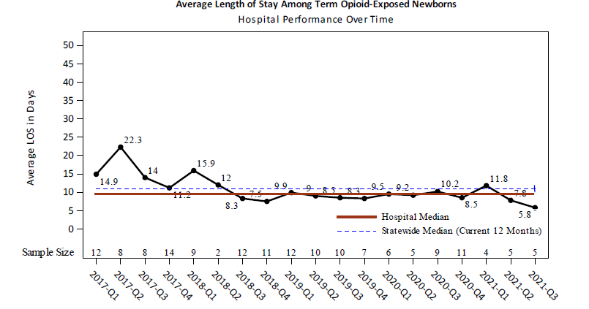
Snapshots
Percent of mothers of OEN’s on MAT
Average length of stay among term Opioid Exposed Newborns
Data is from LGH delivery records, submitted to REDCap database and analyzed by PNQIN
Notes:
Moms on MAT: median 86%
Moms using illicit opioids: median 35-40%
LOS for infants used to be 2-3 weeks, now average 6-10 days

Slide 8
Community Liaison
Facilitate/host the quarterly Lowell Perinatal SUD Collaborative- Early Intervention, DCF, LCHC, MAT providers, LGH nursing and SW, residential treatment providers, Bridge Clinic
SMART Study- one of our OB practices is part of a multi-site research study originating out of Yale University which is comparing two models of care for pregnant women with OUD: a Care Coordination model vs an ECHO model
Notes:
Give example of M. Hall and new to the field of maternal SUD.
ECHO- Extension for Community Health Care Outcomes

Slide 9
Liaison to Community (cont)
Liaison with LCHC
Regular check-ins with SMSF Care Coordinator
Referrals for SMSF group
Referrals for Prenatal Pediatric Consults at LGH-through nursing or RC.
Notes:
SBIRT- Screening, Brief Intervention and Referral to Treatment- if you get a positive screen during the 5P’s, what is your next step?

Slide 10
Supporting Moms Strengthening Families Program
Presented by:
Cheryl Flanders, Certified Recovery Coach, LADC II
Notes:
JENNIFER AND CATIE introduce

Slide 11
Supporting Moms Strengthening Families Program
This HRSA grant was allotted to the OBAT Team for the development of the Moms Program-SMSF
Started in 2019 for prenatal and postpartum women with SUD
May be referred by anyone, i.e., professionals, family members, other moms in the group
I contact clients to assess the appropriateness for the SMSF group
Meet the client where they are at-active addiction or in recovery from addiction from any substance
These women are not required to be a patient of the health center
The goals are to educate and engage moms about the services that are available to them
Insurance is not an issue
If the patient is appropriate for the group I will then enroll them in the SMSF

Slide 12
SMSF is a team approach to support women and their families up to a year after delivery
Services include:
Medication Assisted Treatment (Buprenorphine)
Nurse Care management
Behavioral Health Services
Educational Support Groups
Prenatal tours at Lowell General Hospital
Peer to peer recovery support
Connections to community resources
Weekly Zoom meetings

Slide 13
SMSF metrics

Slide 14
Other resources once a 51A is filed with DCF
Due to the stigma associated with SUD and addiction many pregnant women are hesitant to ask for help.
Once 51A is filed often women request services to help with their addiction/recovery.
Many times referrals will come from DCF into the SMSF group
Meeting the moms where they are at: Do they need safe housing, detoxification or addiction treatment programs according to ASAM Criteria. What are their goals?
Are they requesting a residential treatment program which will work towards reunification of their infants if in fact they are removed from their custody.
DCF is required to place a referral to IHR (Institute for Health and Recovery)
IHR will complete the intake process to determine the appropriate treatment program for the moms

Slide 15
Office Based Addiction Team
Lowell Community Health Center offers outpatient treatment of alcohol and opioid use disorders utilizing Medication Assisted Treatment (MAT). Includes Suboxone (Buprenorphine-Naloxone) and Vivitrol (Naltrexone)
Utilizing a team approach, primary care and behavioral health providers develop individualized care plans that promote overall wellness.
Counselors and Recovery Coaches offer case management and individual and group support.
Overdose prevention through our PASS (prevention and screening services) program, anyone can obtain nasal naloxone ( Narcan) which can help reverse the effects of an opioid overdose. You do not need to be a patient to access the walk-in service.
Training on overdose prevention at no cost.
Narcan is also available for purchase in our pharmacy.
No one will be denied access to care because of inability to pay.

Slide 16
ATR PROGRAM ( Access To Recovery)
This program is under the IHR umbrella
LCHC recently became an affiliate which a designated employee refers clients who meet criteria for this program
Clients must be abstinent from all illicit substances
As the ATR liaison I submit a referral to ATR who then completes their intake process.
Clients are required to be working with a substance use provider or facility.
Clients can chose from various services that are offered by ATR which include:
5 months of paid sober housing
Shopping spree at Walmart ($500.00)
Help accessing identifications, driver's license, birth certificates, or other forms of IDS
Free bus passes in the greater Lowell area
Assistance with disability benefits

Slide 17
ATR Job Readiness Program
3 week program
Laptop is given to clients for access to this program via zoom classes. Laptop is returned to ATR once the client completes the program
Program assists clients with resumes, cover letters, interviewing skills, job search resources. MASS Hire number is given to the clients which enables them to help alleviate job hiring scams.
Clients are required to follow through utilizing their skills to obtain employment.
ATR coordinator follows clients for six months.
ATR reports back to referral source for updates and how clients are doing in the program.
Upon completion of this program clients receive a check for $600.00

Slide 18
Stories
Tracy- delivered first child at LGH and subsequently disclosed active opioid use during pregnancy. MAT initiation and follow up with SMSF. Subsequent collaboration during second pregnancy (need to identify out of state resources).
Maria- became sober during first pregnancy with the support of SMSF, relapsed after birth of child and loss of custody. Now in active treatment during second pregnancy, receives support through SMSF and referred back to LGH for prenatal consult.

