Slide 1
NORTH CENTRAL
COMMUNITY ACTION
TEAM (NCCAT)

Slide 2
What Is NCCAT?
NCCAT works with the Community Health Network of North Central Massachusetts (CHNA9) to provide greater regional support to prevent alcohol, marijuana, and nicotine use among youth ages
9-20.
The CHNA9 service area includes 24 towns and 3 small cities (Fitchburg, Gardner, and Leominster), with a total population of 270,652.
LUK was awarded the 5-year Strategic Prevention Framework – Partnerships for Success grant through the Substance Abuse and Mental Health Services Administration (SAMHSA).

Slide 3
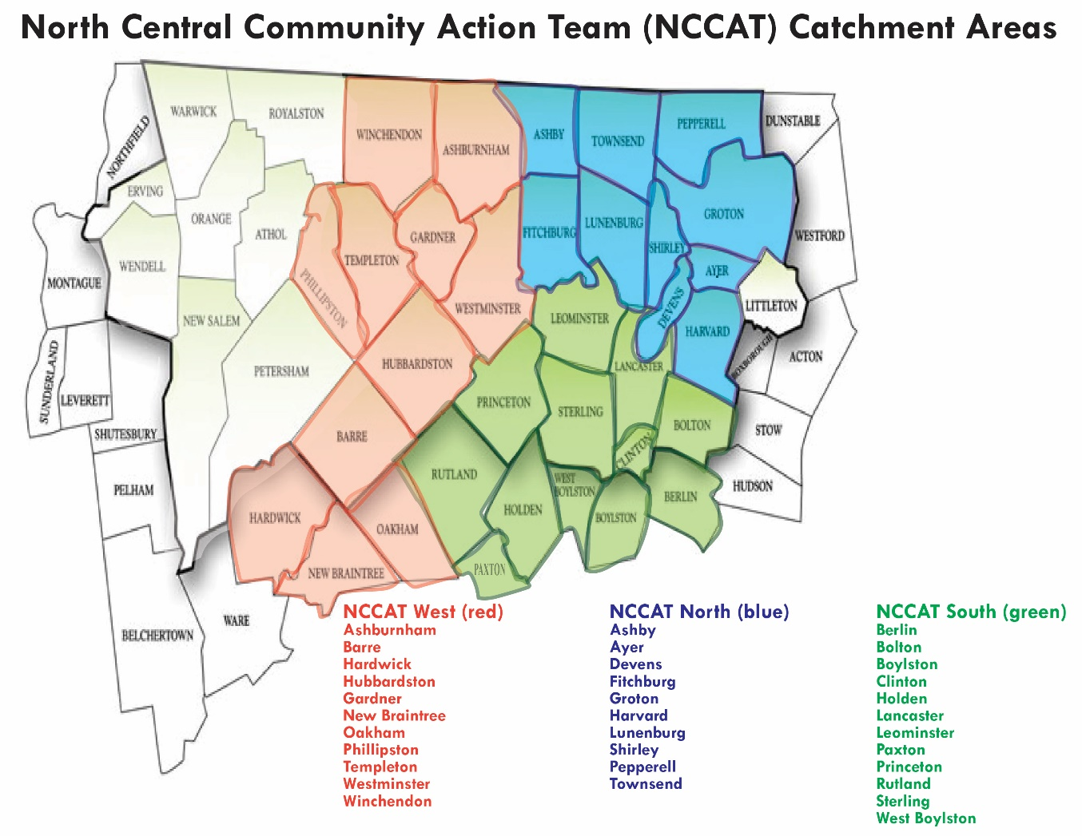

Slide 4
The Work of NCCAT
Community asset mapping and needs assessment
Evidence-based curriculum implementation in schools and youth organizations
Utilize positive youth development to involve more youth in prevention work
Implement social media marketing campaigns (for youth and parents)
Support local coalitions and help build new ones
Youth substance use prevention education for parents
Mini-grants for youth to organize prevention programming
Policy and practice advocacy and improvement

Slide 5
What we have learned…
School administrators and teachers are concerned about the mental health of students when they come back in the fall.
Vaping has increased dramatically in schools and youth are vaping in class and in bathrooms (easy to hide).
Youth perception of harm of vaping is low. They’re in denial about nicotine being in vapes and still think it’s just water vapor.
Youth perception of harm of marijuana is low given it’s legalization and prevalence.
Increased need for social emotional support in schools.

Slide 6
What we have learned (continued)…
In-house school diversion programs are needed.
Access to substance use resources, therapy, and treatment is an issue in this region.
More parent support is needed as many don’t know what to do to help their children who are using.
The MA Interscholastic Athletic Association (MIAA) is challenging schools to use education as opposed to punitive consequences for athletes caught using substances.
Many youth aren’t using opioids; however, alcohol, marijuana and nicotine can lead to harder drug use.

Slide 7
What are young people saying?
“Youth try drugs and alcohol because they want to look cool and give into peer pressure.”
“Many youth want to quit using but need resources.”
“It’s important to ask youth why they’re using before punishing them.”
“Addiction runs in my family, so I know the effects of drugs and alcohol.”
“Youth need help to develop stress management and coping skills.”
“I don’t use because I’m too busy with school and activities.”

Slide 8
Community Opinion on Promising Practices
Start prevention education younger
Educate youth on the biology of addiction and effects on brain development
Educate school staff, teachers, and parents on signs of use
Include more education on healthy living and basic life skills
Mentoring programs are needed, including peer mentorship
Need for more after-school programs for youth not involved in sports
Implement positive messaging campaigns (i.e. “Proud to be me, substance free”)
Incorporate more Social Emotional Learning in schools and youth organizations
More school diversion programs are needed vs. suspension

Slide 9
This summer, LUK staff is offering virtual workshops for youth and parents. Contact us for more details!
LUK staff are trained in the following evidence-based curricula:
LifeSkills Training for middle and high school students
LifeSkills youth substance use prevention for parents
Prevention Plus Wellness marijuana and vaping prevention for middle and high school students
**87% reduction in substance use has been reported amongst middle school students after learning LifeSkills**
If you have specific needs for your school or organization, let’s talk more.

Slide 10
Contact Us Rose Gage Substance Use Prevention Coordinator rgage@LUK.org 545 Westminster Street Fitchburg, MA 01420 LUK.org/Prevention | NCCAT@LUK.org | 800-579-0000

